Slide 1
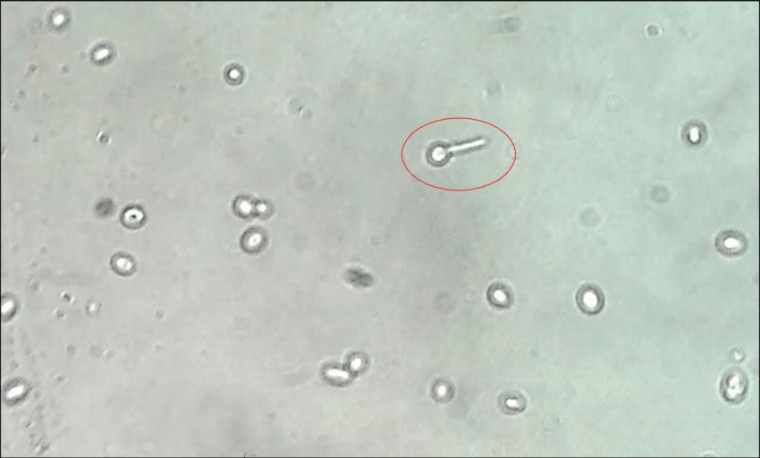
Candida albicans Germ tube formation

Slide 2
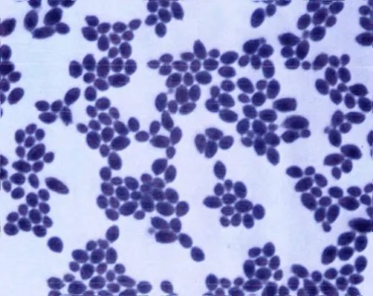
Candida albicans

Slide 3
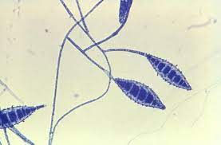
Microsporon canis

Slide 4
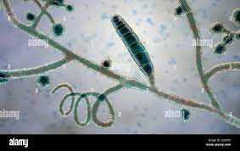
Trichophyton mentagrophytes

Slide 5
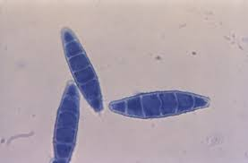
Microsporon gypseum

Slide 6
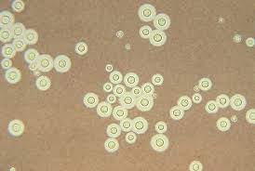
Cryptococcus neoformans

Slide 7
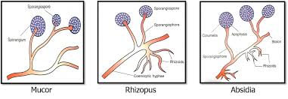
Rhizopus, Mucor, Absidia

Slide 8
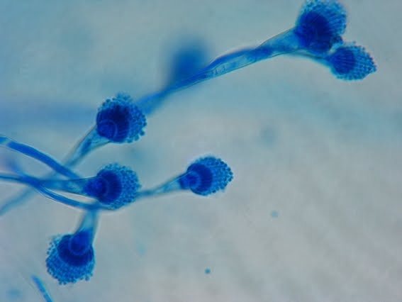
Aspergillus

Slide 9
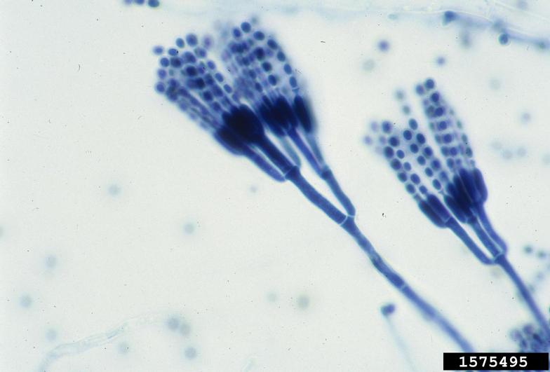
Penicillium

